Slide 1
Cloud Accelerator
FASTER, MORE EFFICIENT, SECURE CLOUD MIGRATIONS

Slide 2
Table of Contents
01
Common Cloud Migration Challenges
02
Cloud Accelerator & How It Helps
Cloud Ecosystem With vs. Without Cloud Accelerator
03
04
Financial Benefits of Using Cloud Accelerator
05
Cloud Accelerator: Customer Success Story

Slide 3
01. COMMON CLOUD MIGRATION CHALLENGES
01. Common Cloud Migration Challenges
02. Cloud Accelerator & How It Helps
03. Cloud Ecosystem With vs, Without Cloud Accelerator
04. Financial Benefits of Using Cloud Accelerator
05. Cloud Accelerator: Customer Success Story

Slide 4
Deciding to make an enterprise shift to cloud is only the first step.
HGS DIGITAL

Slide 5

What all do you need to think about?
How do I ensure monitoring?
How will I ensure security guardrails?
What standards do I follow for creating resources?
Can I still leverage on-premises?
Can I use my existing CI CD pipeline?
How do I secure my data?
Does each application get its own account, or do I share? Who do I share with?
How do I break down SDLC environments? Do I get a choice?
Can I choose different cloud providers?
Will my departments use their own vendors/accounts?
How will I know how much I am spending?

Slide 6





Common Cloud Migration Challenges
Cost
Efficiency
Security
Expertise
Integration
Dedicated operations teams, slow migration, hybrid infrastructure, custom tools development
The availability of the operations teams is a bottleneck for migration process
Security of ecosystem relies totally on the ability of the security team
It is hard to find highly skilled cloud experts. Even harder to train existing employees.
Requires development of lot of custom tools to integrate with existing services
It’s common to face challenges around cost/spending, driving efficiency across the various disparate teams who play a role in the cloud migration process, to ensure security across the cloud ecosystem without having the internal security team becoming a bottleneck, struggles to find and keep seasoned cloud resources or trying to train their existing team, and with integrating with custom tools and services.

Slide 7
02. CLOUD ACCELERATOR & HOW IT HELPS
01. Common Cloud Migration Challenges
02. Cloud Accelerator & How It Helps
03. Cloud Ecosystem With vs, Without Cloud Accelerator
04. Financial Benefits of Using Cloud Accelerator
05. Cloud Accelerator: Customer Success Story

Slide 8
Cloud Accelerator & How It Helps
Cloud Accelerator provides a secure and operationally efficient cloud ecosystem, letting companies focus on adding value to their customers. It saves time and money to enterprises and accelerates cloud adoption.
Cloud Accelerator is a cloud adoption acceleration framework that combines:
Tools
Best practices culled from decades of experience
Security and governance
Automation
We align with your team to define and establish your best practices, requirements and security guardrails once as a repeatable framework that you can leverage moving forward across your enterprise initiative – reducing churn and rework.

Slide 9

Why should you shift to Cloud Accelerator?
Removes fears and barriers to expeditious cloud adoption
Supports multi-cloud/hybrid cloud strategy
Ensures security and governance best practices are in place for all deployments
Eliminates opportunity for human error/deviance from policies/best practices
Estimated cost of a customer build of a similar cloud acceleration framework solution estimated to be reduced by roughly 80+% when leveraging our tool vs. custom build solution
Average workload migration times reduced from 3-4 months down to a couple of weeks, multiplied by the # of workloads being migrated across the enterprise, multiplied by the resource hours saved (times the hourly rates)... the savings start to pile up!
Average account infrastructure provisioning time reduced from 3-4 weeks down to just 30 minutes

Slide 10



Key Features of Cloud Accelerator
Foundational Features
Developer Features
Management Features
Organization setup (account, subscription, and project)
Network architecture design patterns and setup
Security blueprints and policies enforcement
Fully automated cloud governance
Pre-built Terraform modules for fast & secure deployments
Sentinel policies preventing developers from creating non-compliant resources
Service catalog for standard resource provisioning
Cloud account vending machine
Spend dashboard for financial planning & budgeting
Compliance dashboard & reports
Enabling cloud across the enterprise, foundational features make it easier for users in functional areas to coordinate activities.
Curated technical tools give your development team exactly what they need for frictionless management.
High level overviews into the measures your management team cares about, in simple formats.

Slide 11
Key Features of Cloud Accelerator
Foundational Features
Developer Features
Management Features
Organization setup (account, subscription, and project)
Network architecture design patterns and setup
Security blueprints and policies enforcement
Fully automated cloud governance
Pre-built Terraform modules for fast & secure deployments
Sentinel policies preventing developers from creating non-compliant resources
Service catalog for standard resource provisioning
Cloud account vending machine
Spend dashboard for financial planning & budgeting
Compliance dashboard & reports
Enabling cloud across the enterprise, foundational features make it easier for users in functional areas to coordinate activities.
Curated technical tools give your development team exactly what they need for frictionless management.
High level overviews into the measures your management team cares about, in simple formats.

Slide 12
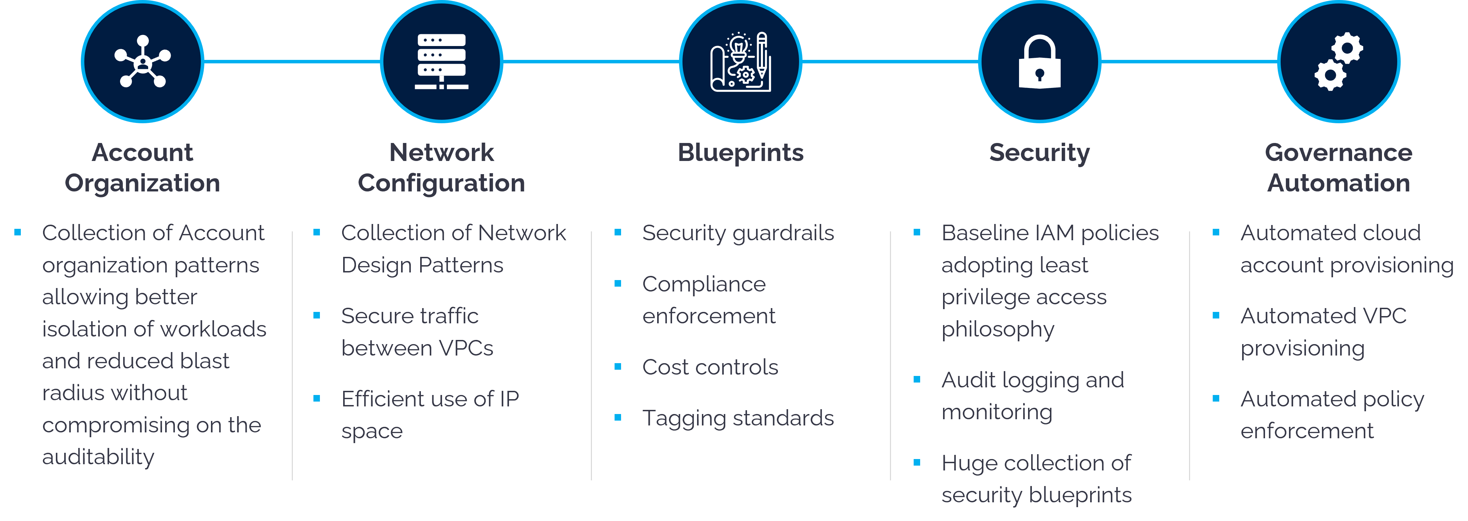
Key Features of Cloud Accelerator
Foundational Features
We work alongside your team ONE TIME to identify your very specific requirements so that we can incorporate your policies, guardrails, security and governance.

Slide 13
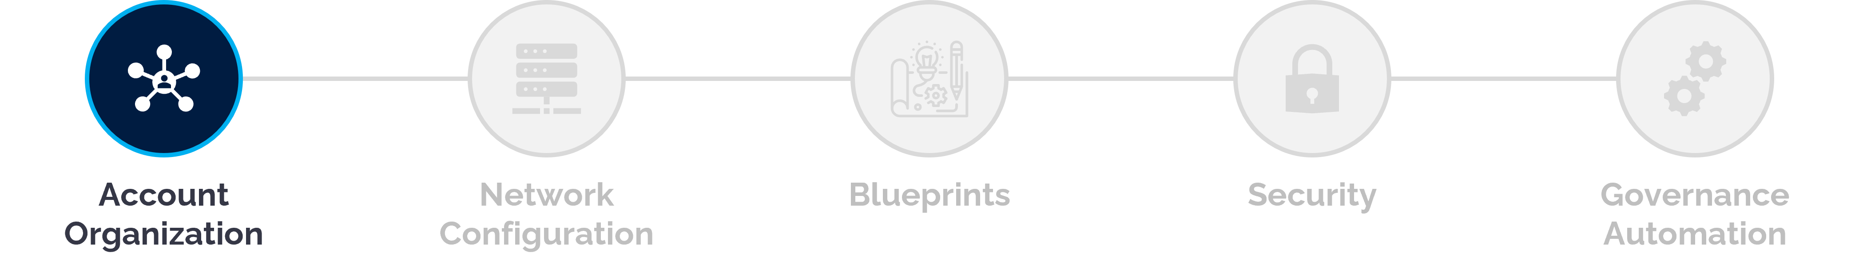
Key Features of Cloud Accelerator
Foundational Features
A good account organization design:
Ensures isolation of workloads based on environment category, data sensitivity and cost centers,
Reduces blast radius
Allows applying policies in a centralized way
Takes advantage of volume discounts and promotes auditability
Cloud Accelerator offers a collection of account organization patterns to choose from
Account vending machine provisions accounts under the right OU/folder automatically based on the information provided by the application team

Slide 14
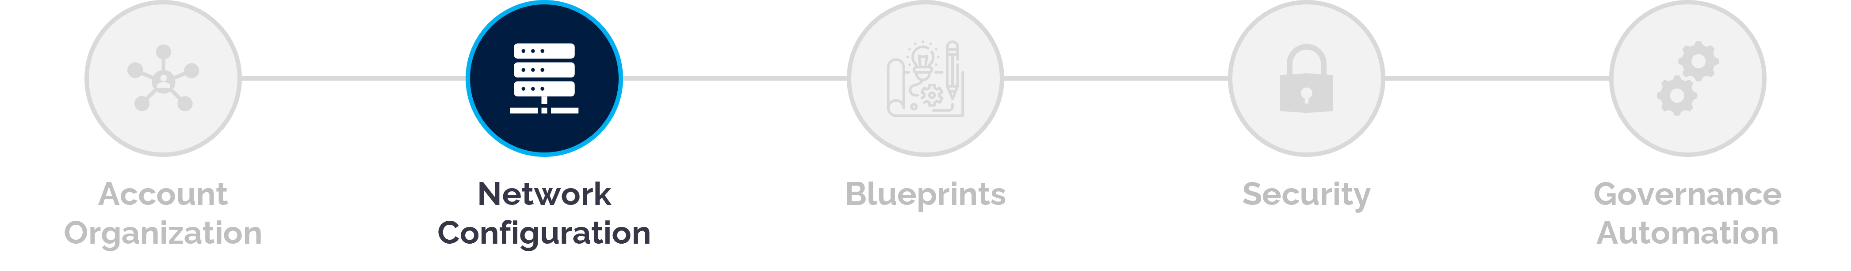
Key Features of Cloud Accelerator
Foundational Features
A good network design:
Uses IP space efficiently, provides isolation between workloads and enables access to shared services with minimal latency
Cloud Accelerator offers a collection of network design patterns for companies to choose from
Account vending machine automatically provisions the network based on the chosen design
Can be configured to work with enterprise IPAM solutions

Slide 15
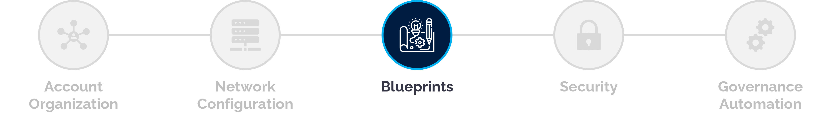
Key Features of Cloud Accelerator
Foundational Features
Blueprint is a framework through which companies can centrally enforce
Security and operational best practices
Compliance to legal requirements
Identified baseline requirements by operations teams like billing, networking…
Cloud Accelerator implements default blueprints offered by cloud providers out-of-box
Cloud Accelerator offers huge list of custom blueprints for companies to choose and enable

Slide 16
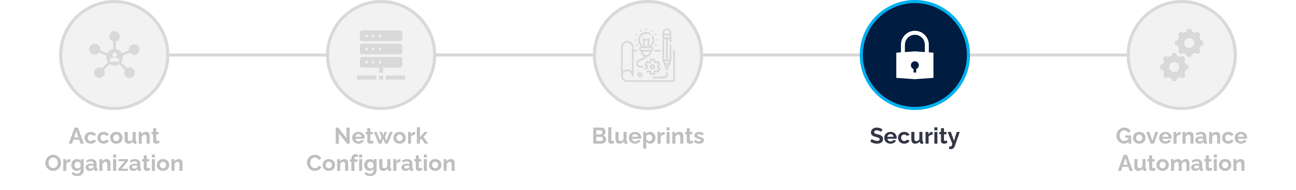
Key Features of Cloud Accelerator
Foundational Features
Security features include:
Security baselines via blueprints
A collection of baseline IAM roles & permissions for granting access to core teams
A central logging account – stores all the events across the board
Automation-only workflow for developers to provision cloud resources
Security blueprints, Terraform modules, sentinel policies and service catalog products ensure that every resource created in the cloud ecosystem is secure
Vault based secret management – allows security team to define secrets management policy across the board with the same process

Slide 17
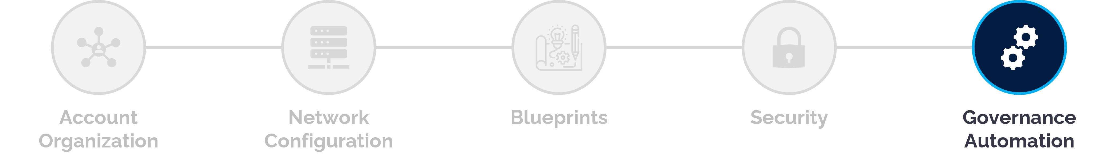
Key Features of Cloud Accelerator
Foundational Features
Significance of Governance Automation:
Cloud Accelerator’s governance automation is powered by blueprints + landing zone + account vending machine
The automation includes creating a secure and compliant cloud ecosystem, enforcing those policies on resources created by application team, provisioning cloud accounts, Terraform workspaces and Vault resources for application teams to migrate their workloads and generating reports for the consumption of operations and leadership teams
This automation eliminates the need for human intervention in day-to-day account provisioning process and let the operations teams focus on making incremental improvements to the ecosystem

Slide 18
Key Features of Cloud Accelerator
Foundational Features
Developer Features
Management Features
Organization setup (account, subscription, and project)
Network architecture design patterns and setup
Security blueprints and policies enforcement
Fully automated cloud governance
Pre-built Terraform modules for fast & secure deployments
Sentinel policies preventing developers from creating non-compliant resources
Service catalog for standard resource provisioning
Cloud account vending machine
Spend dashboard for financial planning & budgeting
Compliance dashboard & reports
Enabling cloud across the enterprise, foundational features make it easier for users in functional areas to coordinate activities.
Curated technical tools give your development team exactly what they need for frictionless management.
High level overviews into the measures your management team cares about, in simple formats.

Slide 19
Key Features of Cloud Accelerator
Account Vending Machine & Tools
Developers can request and instantly get their cloud account and access using Account Vending Machine
Account vending machine creates the following artifacts:
An account/project/subscription for the requesting team
Active Directory groups to grant access on cloud account, Terraform workspace and Vault to application teams
Private network on the cloud account
Distribution list used for communication
Read-only access on cloud console for developers
Terraform workspace connected to target cloud accounts with predefined set of permissions
Vault KV store to manage application secrets
Access to a huge list of secure Terraform modules which they can leverage to provision their resources on cloud
Developer Features

Slide 20


Key Features of Cloud Accelerator
ENTERPRISE USER TYPES
Has solid understanding of their application.
Likely to have no understanding of cloud.
Knows they need and environment to run their workload.
Have little to no understanding of the underlying infrastructure.
Has secured funding approvals for cloud.
Developer Features
Business User
Both the user types likely lack knowledge of enterprise governance, best practices, guardrails and security requirements.
Has solid understanding of their application.
May have a decent understanding of cloud.
Has a deeper understanding of the type of environment they need to run their workload.
Has worked with IT to validate their architecture needed.
Has secured funding approvals for cloud.
Technical User
With Cloud Accelerator, both types of users (Business User & Technical User), can easily provision their services by taking advantage of the inbuilt service catalog modules and terraform modules without risk of falling outside of enterprise best practices and without the need to involve the technical resources within their organization

Slide 21
Key Features of Cloud Accelerator
Foundational Features
Developer Features
Management Features
Organization setup (account, subscription, and project)
Network architecture design patterns and setup
Security blueprints and policies enforcement
Fully automated cloud governance
Pre-built Terraform modules for fast & secure deployments
Sentinel policies preventing developers from creating non-compliant resources
Service catalog for standard resource provisioning
Cloud account vending machine
Spend dashboard for financial planning & budgeting
Compliance dashboard & reports
Enabling cloud across the enterprise, foundational features make it easier for users in functional areas to coordinate activities.
Curated technical tools give your development team exactly what they need for frictionless management.
High level overviews into the measures your management team cares about, in simple formats.

Slide 22








Key Features of Cloud Accelerator
Dashboards & Reports
Centralized dashboard to visualize both cost & compliance across account/OU
Detailed reports to track planned cost vs actual spend and compliance vs non-compliance
Management Features

Slide 23
03. CLOUD ECOSYSTEM WITH VS. WITHOUT CLOUD ACCELERATOR
01. Common Cloud Migration Challenges
02. Cloud Accelerator & How It Helps
03. Cloud Ecosystem With vs, Without Cloud Accelerator
04. Financial Benefits of Using Cloud Accelerator
05. Cloud Accelerator: Customer Success Story

Slide 24

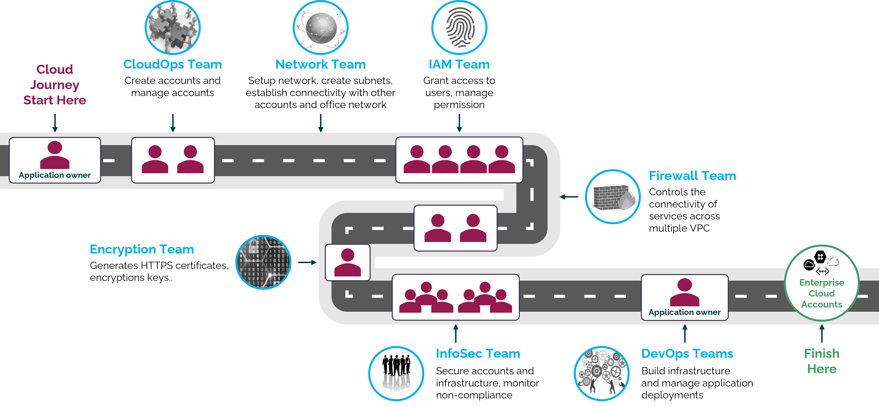
Cloud Ecosystem without Cloud Accelerator
This is an example of what an enterprise cloud ecosystem looks like...with 8- or sometimes even more disparate groups that a workload owner must interface with along their sequential path to cloud.

Slide 25
Cloud Ecosystem without Cloud Accelerator
Keep in mind, that in an enterprise-wide cloud directive, each of those teams serve as single sources for the hundreds, or even thousands of workload owners that are trying to move to cloud.

Slide 26
Cloud Ecosystem without Cloud Accelerator
Looking at this, you can start to see how things can quickly get bogged down at various stops in the process and cause huge delays in the cloud migration process.

Slide 27
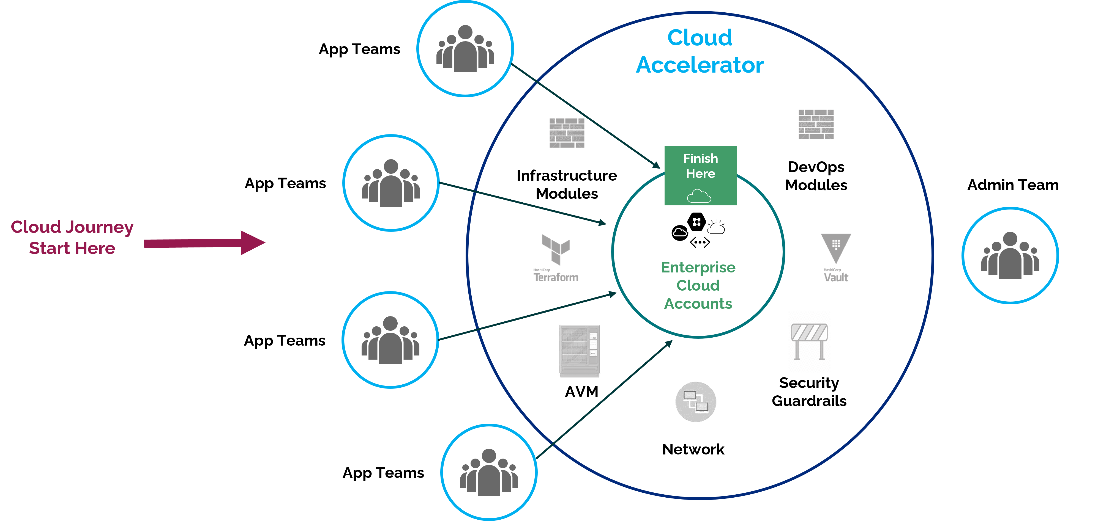
Cloud Ecosystem with Cloud Accelerator
Now Multiple Workloads can migrate simultaneously without facing bottlenecks.
Here we see what an enterprise cloud ecosystem looks like with Cloud Accelerator.
Now, you’ll see that the processes and stops that were previously sequential with…

Slide 28
Cloud Ecosystem with Cloud Accelerator
Now Multiple Workloads can migrate simultaneously without facing bottlenecks.
…many potential bottlenecks in the migration journey are now incorporated into a framework already designed to meet the enterprise standards across all those stops in the journey, simultaneously…

Slide 29
Cloud Ecosystem with Cloud Accelerator
Now Multiple Workloads can migrate simultaneously without facing bottlenecks.
…saving time, reducing churn on employees and approval processes, simplifying and accelerating – without sacrificing governance and security.

Slide 30
04. FINANCIAL BENEFITS OF USING CLOUD ACCELERATOR
01. Common Cloud Migration Challenges
02. Cloud Accelerator & How It Helps
03. Cloud Ecosystem With vs, Without Cloud Accelerator
04. Financial Benefits of Using Cloud Accelerator
05. Cloud Accelerator: Customer Success Story

Slide 31
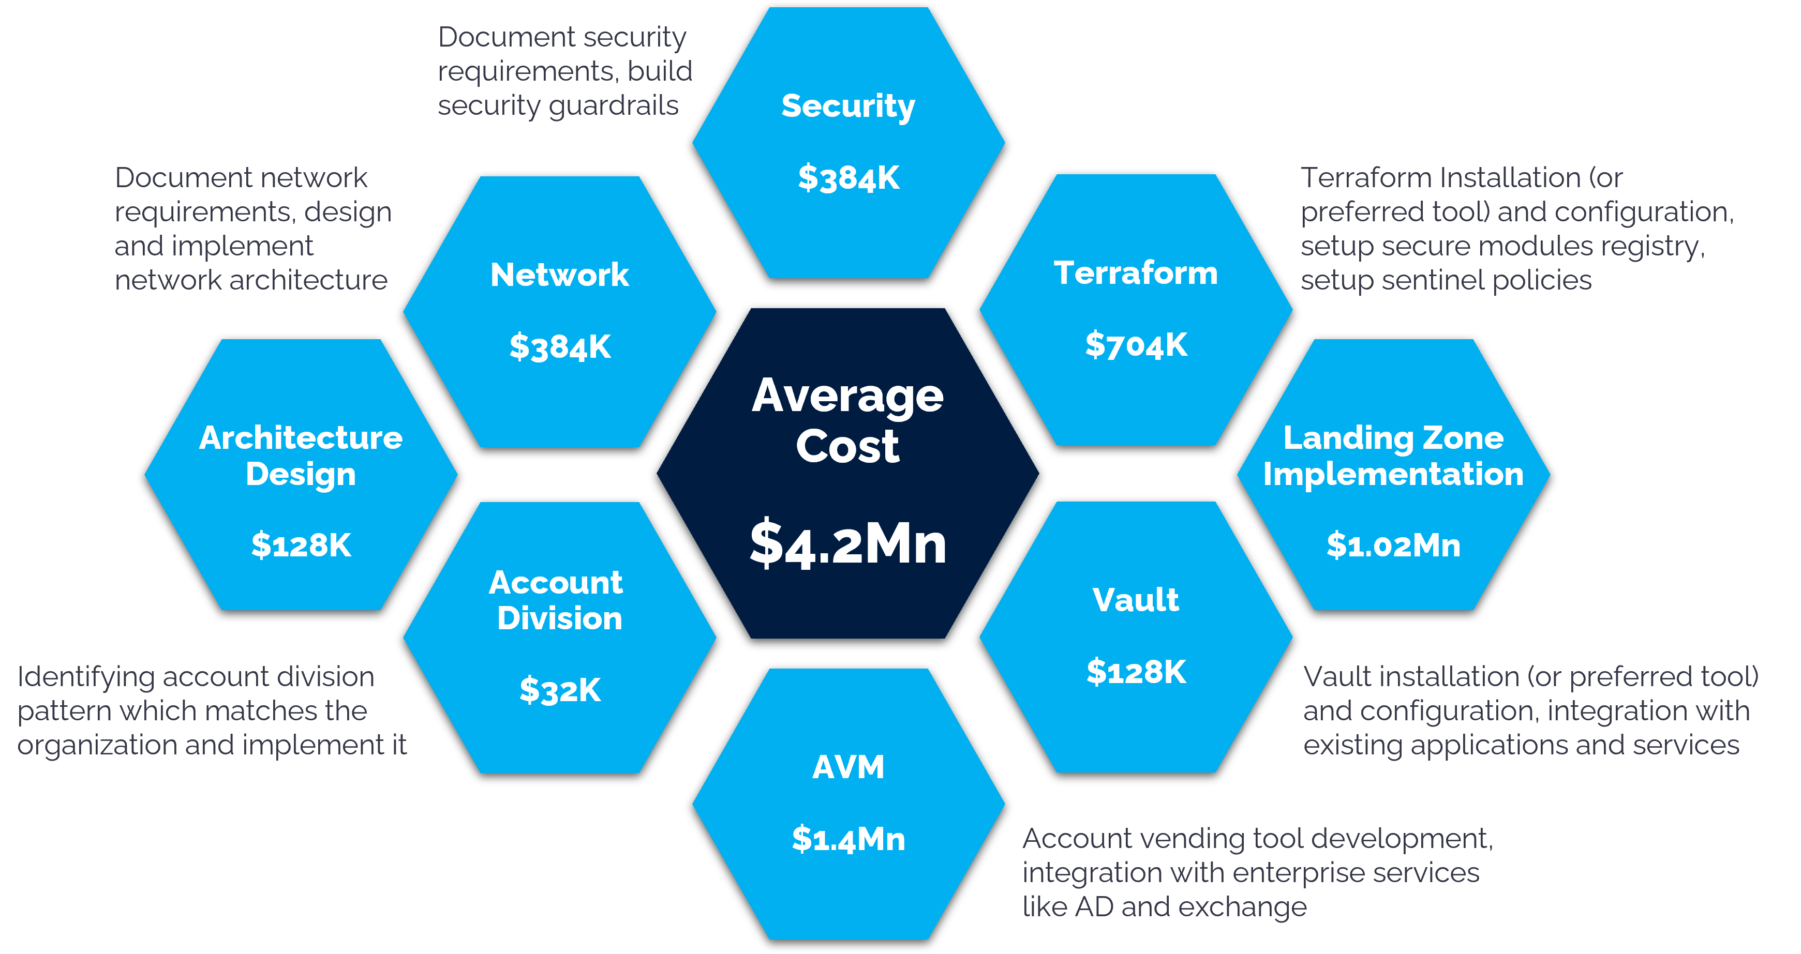
Implementation Cost without Cloud Accelerator
One major challenge with building a similar solution on your own is the struggle to find and retain in-house expertise. Assuming you can find the talent, we estimate your development costs to be very high, the cycles long, and potentially cost- and time-prohibitive.

Slide 32
Financial Benefits Of Cloud Accelerator
Project Level Comparison (‘OOO)
On average, we estimate roughly 90% reduction in the cost of implementation of our tool vs. an in- house build.
Cost of building a similar Platform In house : $4,192,000
Implementing Cloud Accelerators: $419K-$575K (lower end without customizations, higher end if customizations are needed) (duration: 4-6 months)
Average savings to the enterprise: $3.61M-$3.77M
Without HGS Digital – Cloud Accelerator
With HGS Digital – Cloud Accelerator
Account Vending Automation Architect
Security Architecture
Network Architecture
Vault Install & Configure
Terraform Module & Sentinel Policies Development
Terraform Install & Integration
Account Division
Additionally, when moving a workload from on prem to the cloud, you typically see an average of 40% TCO savings*. This tool helps you achieve those savings faster!
*Stratocale Article/David Linthicum reports: https://www.stratoscale.com/blog/clou/cloud-migration-savings/

Slide 33
05. CLOUD ACCELERATOR: CUSTOMER SUCCESS STORY
01. Common Cloud Migration Challenges
02. Cloud Accelerator & How It Helps
03. Cloud Ecosystem With vs, Without Cloud Accelerator
04. Financial Benefits of Using Cloud Accelerator
05. Cloud Accelerator: Customer Success Story

Slide 34
Highlights
BUDGETING
The customized framework provided large volume billing benefit and customized tagging options were deployed to provide an automated way of generating independent invoicing for internal chargebacks.
DATA SECURITY
It was imperative to automate sensitive healthcare information- with the cloud accelerator, the information transfer was automated, thereby removing the possibility of human error in data management.
GOVERNANCE, COMPLIANCE, AND BEST PRACTICES
Compliance and governance were automated and built into the platform. Multiple apps could be on-boarded on the same day, seamlessly and simultaneously, eliminating the sequential need for workloads to be queued up.
CLIENT SUCCESS STORY: HEALTHCARE
HGS Cloud Accelerator fast-tracks cloud migration, drives 80% reduction in implementation costs for healthcare payer
This healthcare payer giant was looking for an enterprise migration from an on-prem to an on-cloud setup. They had over 3,000 apps running on their data center. With just three to four apps being migrated every month, they were unhappy with the velocity of the migration. The client was looking to simplify the migration process, collate and automate best practices and policies, and facilitate spending governance and reconciliation.
Key results
80%
4 WEEKS
3K
reduction in implementation costs
Turnaround time
applications migrated

